Slide 1
Flow Aware Networking
By
Apoorva GM - 01666754
Harish Prakash - 01669175

Slide 2
Outline:
Project Description
Introduction to Quality of Service (QoS)
QoS Control in OpenFlow
Flow Aware Networking(FAN)
Flow Aware Networking Operation
Flow Aware Networking : Types of Flow
Design of the Project
Implementation

Slide 3
Project Description
Monitoring the Patient recovery.
The sensor data streams are often processed at remote data centers, thus requiring data transfer over the network.
The heterogeneous data streams are expected to have different priority, bandwidth and monitoring requirements
The project is to design and implement a SDN controller that identifies data flows and applies network control policies along the data transfer path, in particular at the edge of the network
bandwidth of a flow

Slide 4
Introduction
Quality of Service:
Quality of service (QoS) refers to a network’s ability to achieve maximum bandwidth and deal with other network performance elements like latency, error rate and uptime.
It involves controlling and managing network resources by setting priorities for specific types of data (video, audio, files) on the network.
QoS is exclusively applied to network traffic generated for video on demand, IPTV, VoIP, streaming media, videoconferencing and online gaming.
Notes:
On the Internet and in other networks, QoS (Quality of Service) is the idea that transmission rates, error rates, and other characteristics can be measured, improved, and, to some extent, guaranteed in advance. QoS is of particular concern for the continuous transmission of high-bandwidth video and multimedia information.

Slide 5
Conti..
Software Defined Networking (SDN), as a new paradigm in networking, offers the opportunity to speed-up the adoption of QoS control in the Internet.
The centralized nature of SDN is expected to reduce the complexity that is commonly associated with QoS guarantees.

Slide 6
QoS Control in OpenFlow
QoS in OpenFlow is supported by two features
Queue Table:
A queue is an egress packet queuing mechanism in the OpenFlow switch port.
The OpenFlow protocol does not handle queue management. Queue management (creation, deletion, alteration) is handled by the switch configuration protocol, such as OF-Config or Open vSwitch Database (OVSDB). OpenFlow itself is only able to query queue statistics from the switch.
The queue was first supported in OpenFlow 1.0 with only a guaranteed minimum rate property. Later, it was extended in OpenFlow 1.2 with a maximum rate, which limits the maximum throughput of a queue.
Notes:
Analysis of the traffic-performance relation, linking capacity, demand and performance, for a range of streaming and elastic traffic types leads us to believe adequate performance can be assured much more simply than in the classical QoS architectures and more reliably than in an over-provisioned best effort network. The basis for this belief is our proposition for an architecture called Flow-aware networking, or FAN for short

Slide 7
Conti..
Meter Table:
The meter table is a feature introduced in OpenFlow 1.3. Metering allows ingress rate monitoring of a flow and to perform operations based on the rate of the flow.
There are two operations that can be performed: dropping packets and remarking DSCP bits of the packets.
Unlike a queue, which is a property of a switch port, a meter is attached to flow entries.

Slide 8
Flow Aware Networking
A relatively new architecture for Quality of Service in the Internet
provides an approach to providing class of service differentiation similar to that envisioned by IntServ
is a simple, straight-forward enhancement to the current IP network architecture.

Slide 9
Flow Aware Networking
Goal: Enhance the current IP network by improving its performance under heavy congestion
Key Operational Concepts:
measurement-based admission control
provide assurance of a minimal performance level for each flow
fair scheduling with priorities
fair distribution of available bandwidth
negligible latency for well-behave flows

Slide 10
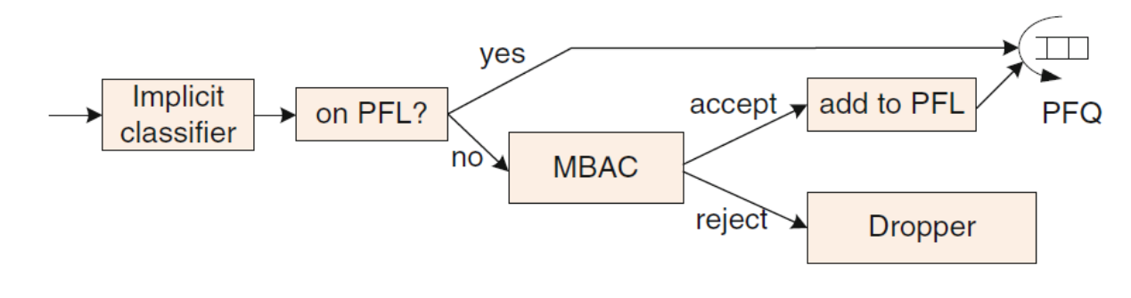
FAN Operations
Classify all incoming packets into flows (note: this is not a service classification, but simply recognition of a unique flow of traffic).
All previously identified flows appear in the Protected Flow List (PFL) and are forwarded (scheduled) unconditionally.
New flows are subjected to Measurement-Based Admission Control (MBAC).
Notes:
Protected Flow List (PFL)
The flow identification process is implicit and its goal is not to divide
flows into different classes, but only to create an instance on which the service
differentiation will be performed. Then, all the flows that are currently in progress
are present on the Protected Flow List (PFL) and are forwarded unconditionally,
whereas all new flows are subject to admission control.

Slide 11
Conti..
MBAC function forwards or drops packets in flows not on PFL based on current link congestion conditions
Reasonable level of congestion, capacity available: add flow to PFL and add to queue.
Congestion above threshold: drop packets.
Notes:
The admission control in
FAN is measurement based (MBAC) which implies that the accept/reject decisions
are based only on the current link congestion status. If a new flow is accepted, it is
put onto the PFL list and then all successive packets from this flow are forwarded
without checking the status of the outgoing link by MBAC.
In FAN, admission control and service differentiation are implicit. In classic
explicit service differentiation architectures, user requirements are signaled to the
network and the nodes perform differentiation actions based on the information
received. For example, the provision of better quality is a consequence of the explicit
identification of a certain transmission. On the contrary, implicit service differentiation
performs differentiation actions based on traffic characteristics and network
measurements.
In FAN, there is no need for a priori traffic specification, as well as no class
of service distinction. Both streaming and elastic flows achieve the necessary QoS
without any mutual detrimental effect. Nevertheless, streaming and elastic flows are
implicitly identified inside the FAN network. This classification, however, is based
solely on the current flow peak rate. All flows emitting at lower rates than the current
fair rate are referred to as streaming flows, and the packets from those flows are
prioritized. The remaining flows are referred to as elastic flows.

Slide 12
FAN Operation: MBAC
Measurement-Based Admission Control (MBAC)
per-flow measurement
existing flows are not subjected to MBAC
each new flow receives identical treatment
when network congestion, at a cross-protect router, reaches a specified threshold, new flows are blocked

Slide 13
FAN: Types of Flows
All admitted flows are characterized in one of two classes:
Streaming flows: those producing traffic at lower than the current fair rate
these flows receive prioritized treatment
packets of these flows are sent through priority queues (PFQ, or PB-DWRR)
hence, low delays and delay variations.
Elastic flows: those with traffic at a rate higher than the current fair rate
fair queuing: fair bandwidth sharing with other elastic flows (better than FIFO).

Slide 14
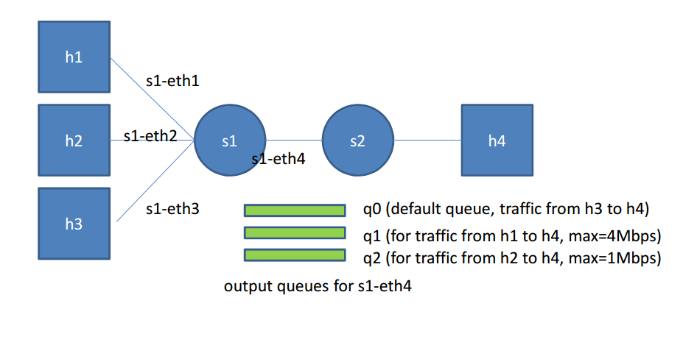

Design :

Slide 15
Implementation
Design/Setup:
A new experiment in Mininet is created which can emulate the required topology that supports openflow controller.
It’s a simple topology consisting of Openv Switches (ovs)
We have used four hosts i.e, h1, h2, h3, h4 which and two switches i.e, s1, s2.
For the controller, we have used the POX controller as it is compatible with the python which is the language of communication between the hosts through the OVS switches and also lay down the bandwidth guarantee and queuing rules inside the controller.

Slide 16
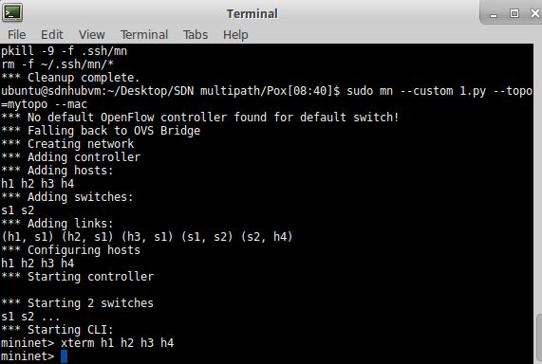
Implementation
Working:
using default controller: all traffic go into the same output queue for s1-eth4

Slide 17
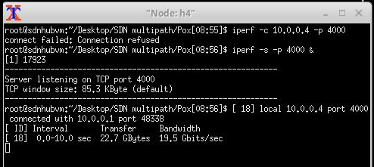
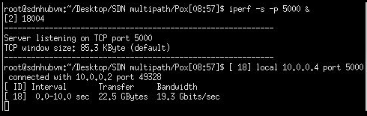

Implementation
For h4, start Iperf servers at port 4000, 5000, 6000 respectively

Slide 18
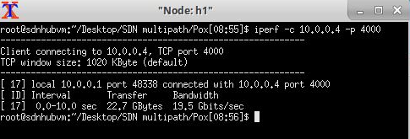
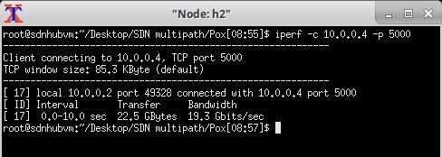
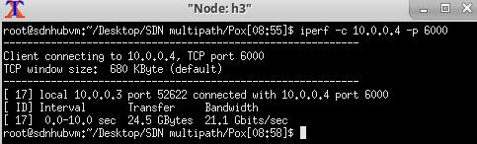
Implementation
Test the throughput from h1 to h4 & h2 to h4 & h3 to h4
The throughputs measured are around 20 Gbps.

Slide 19

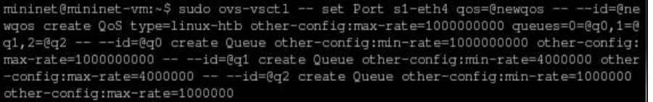
Implementation
using controller: traffic from h1 goes to q1, traffic from h2 goes to q2, traffic from h3 goes to q0
Using ovs-vsctl to create three queues for s1-eth4, i.e. q0, q1, and q2 and to set the rate for each queue

Slide 20
Reference
Providing Bandwidth Guarantees with OpenFlow, by Hedi Krishna, Niels L. M. van Adrichem, and Fernando A. Kuipers
OpenNetMon: Network Monitoring in OpenFlow Software-Defined Networks Niels L. M. van Adrichem, Christian Doerr and Fernando A. Kuipers
FlowQoS: QoS for the Rest of Us M. Said Seddiki, Muhammad Shahbaz , Sean Donovan∗ , Sarthak Grover∗ , Miseon Park∗ , Nick Feamster∗ , Ye-Qiong Song†

Slide 21
Thank You

